Slide 1
Laravel Course
Name: Dhruv Gohil
Batch: D
E.no:23000510

Slide 2
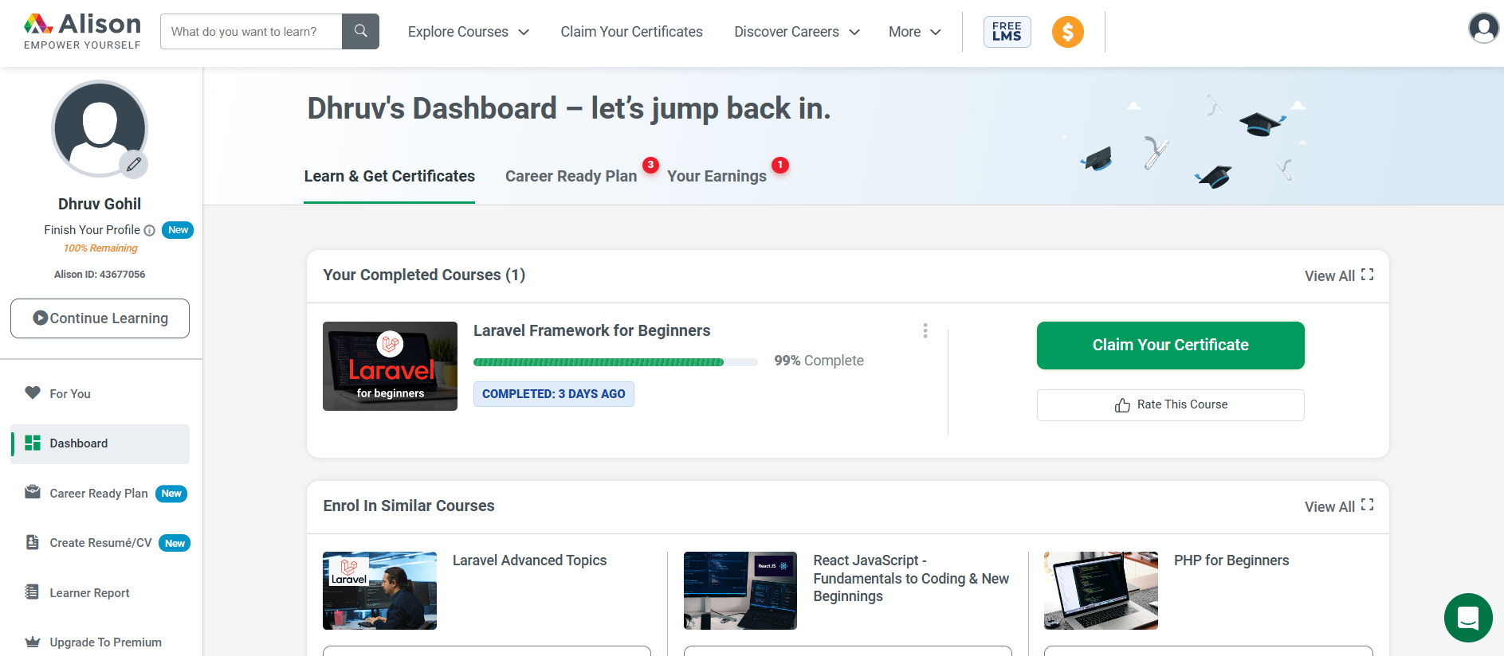
Dashboard:

Slide 3
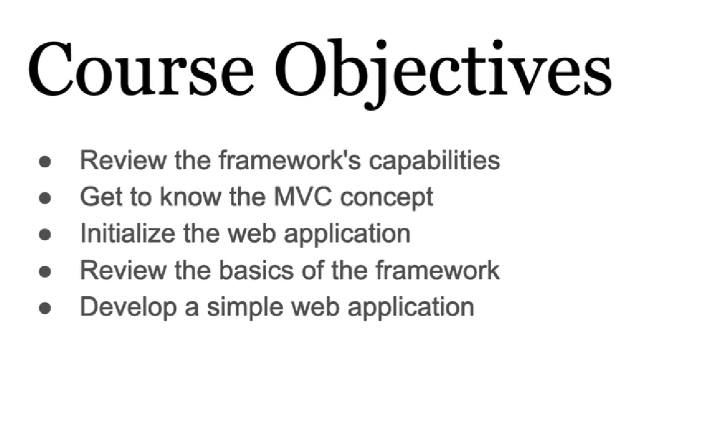
Course Objectives

Slide 4
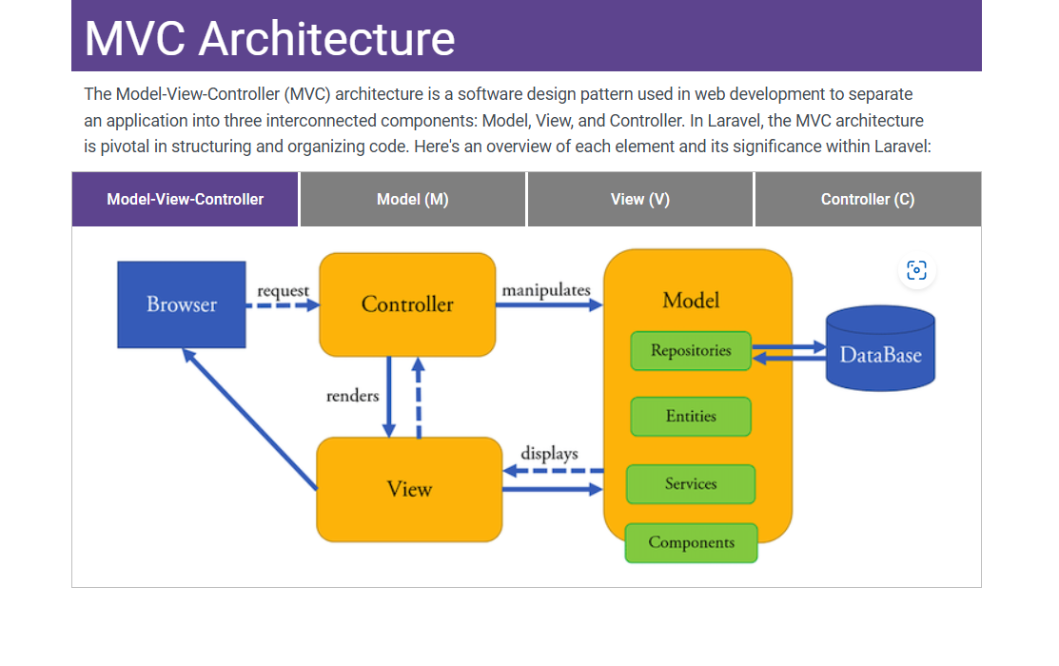

Slide 5
MVC Model view controller is a software design pattern used in web development to separate an application into three interconnects : Model , View and Controller Model : The model represent the data and business logic of the application. View : The View is responsible for presenting the data to the users. Controller :The controllers is acts as an intermediary between the model and view.

Slide 6
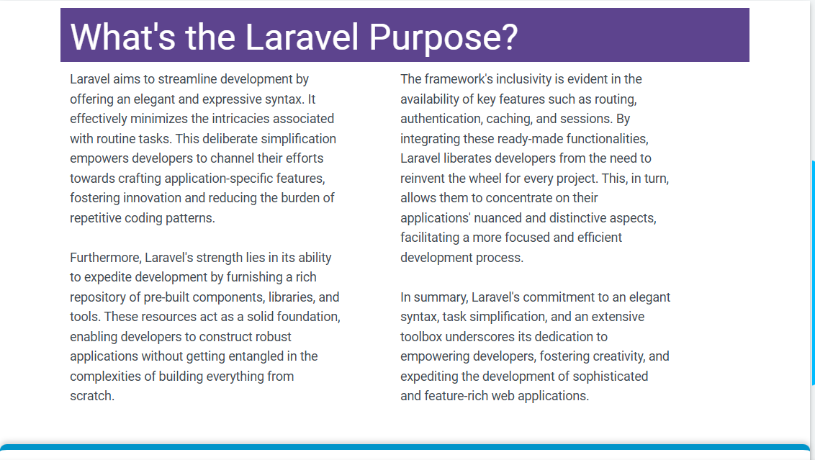
What’s the Laravel Purpose? Laravel is a PHP Framework that helps developers build modern web applications and websites

Slide 7
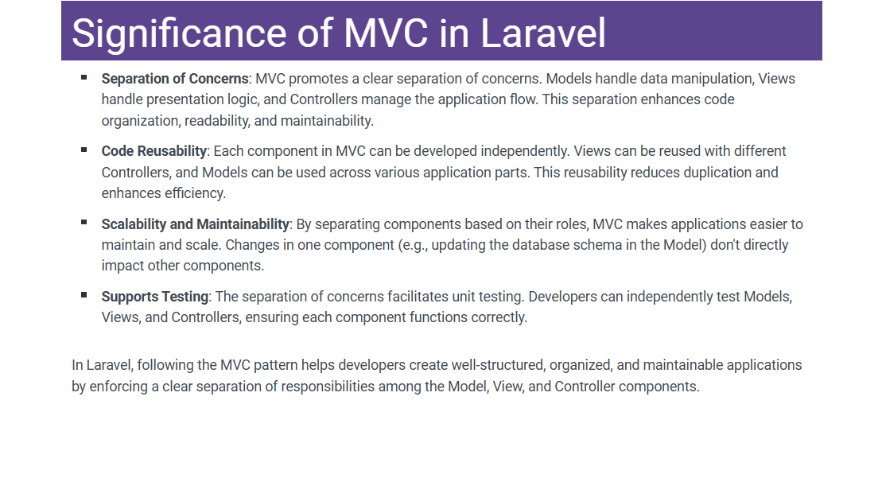

Slide 8
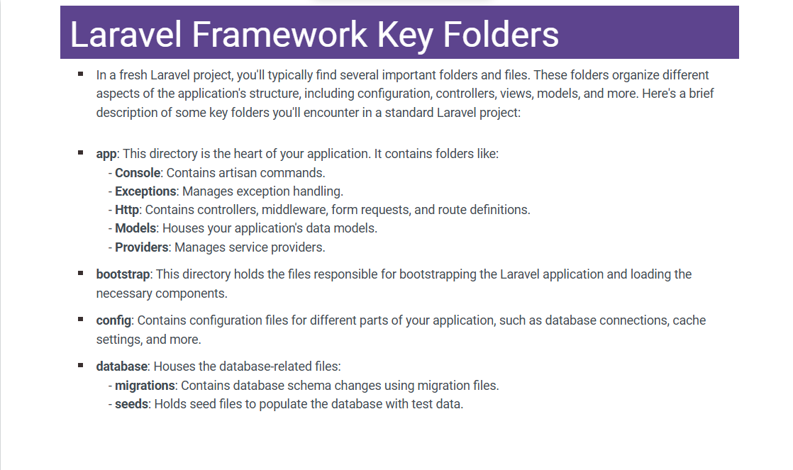

Slide 9
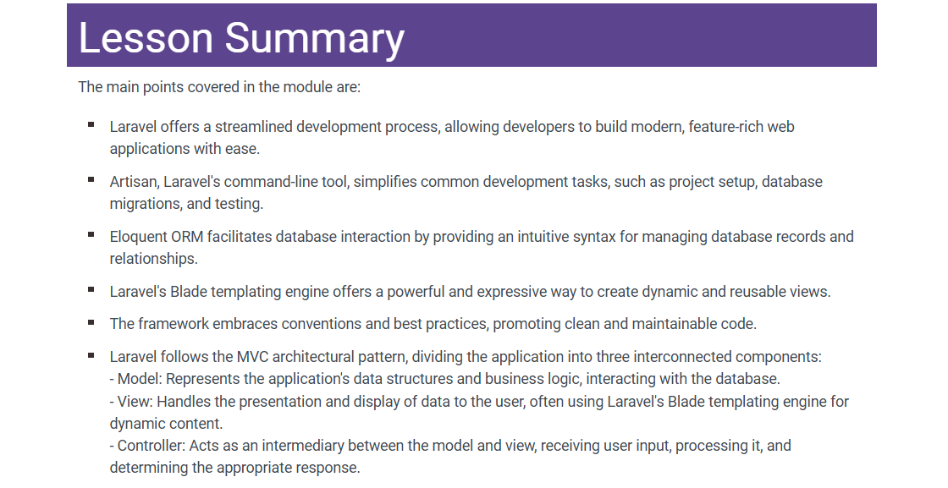

Slide 10
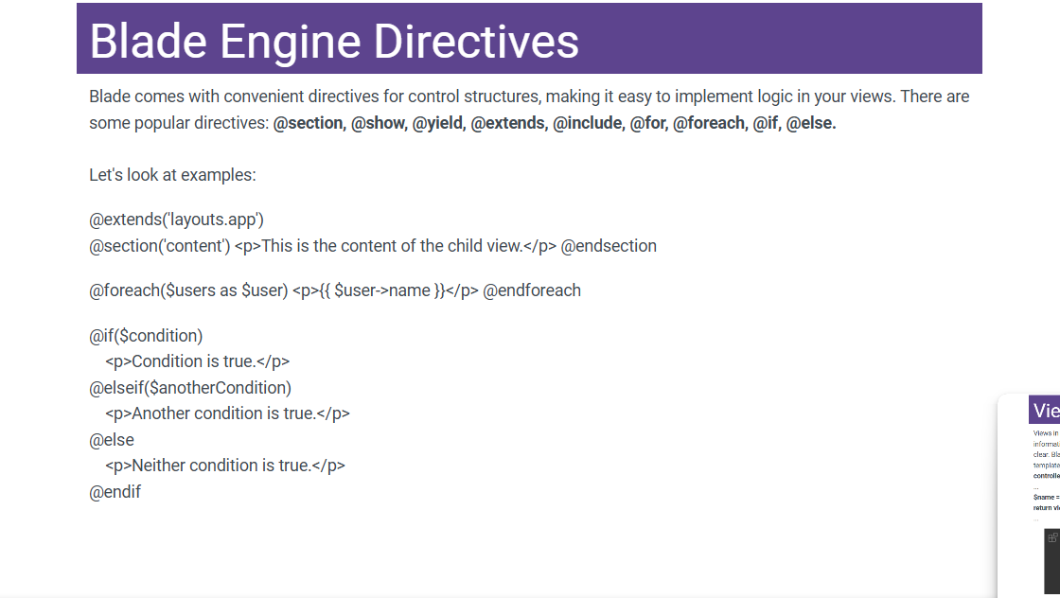

Slide 11
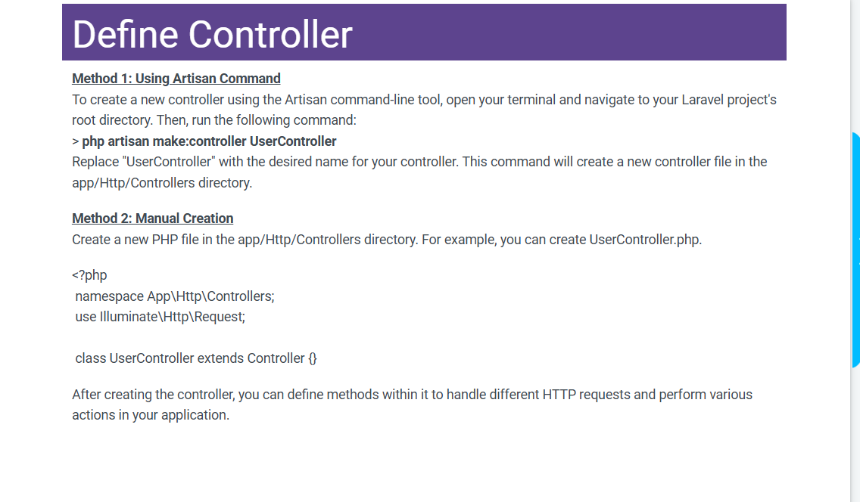

Slide 12
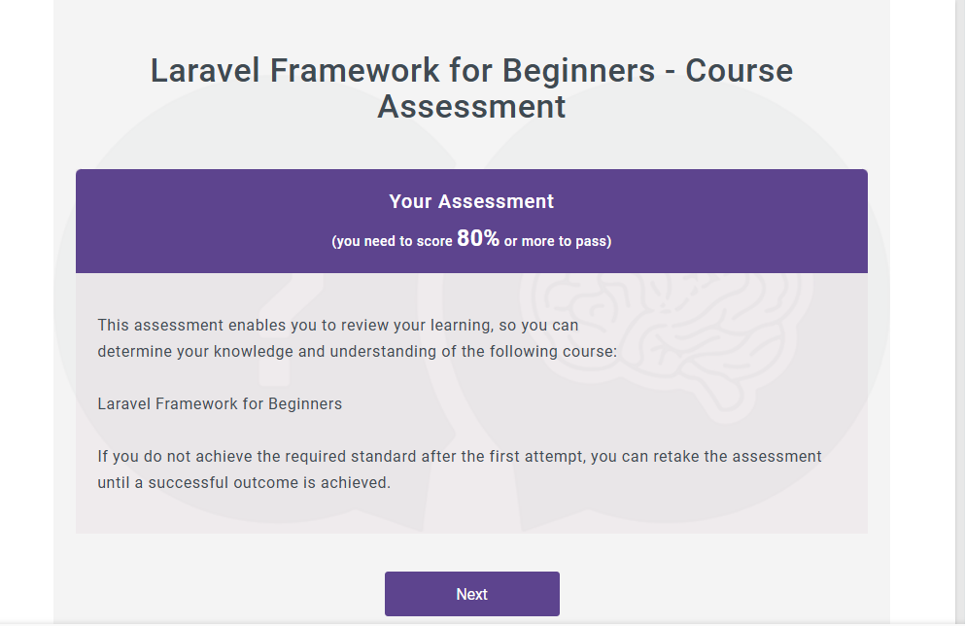

Slide 13
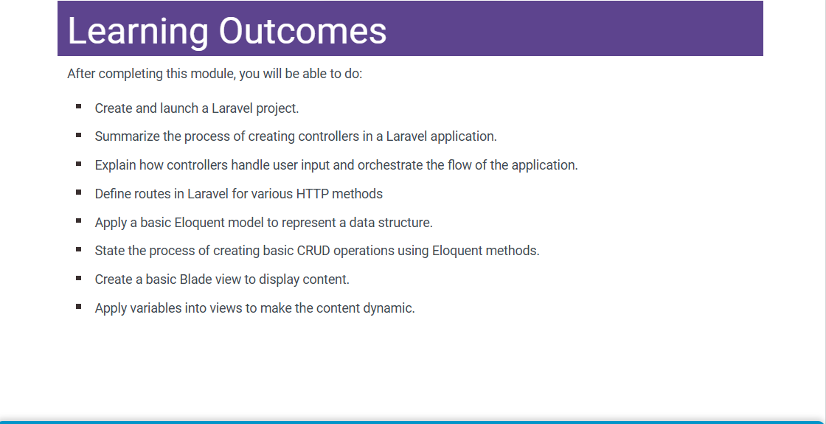
Learning outcomes

Slide 14
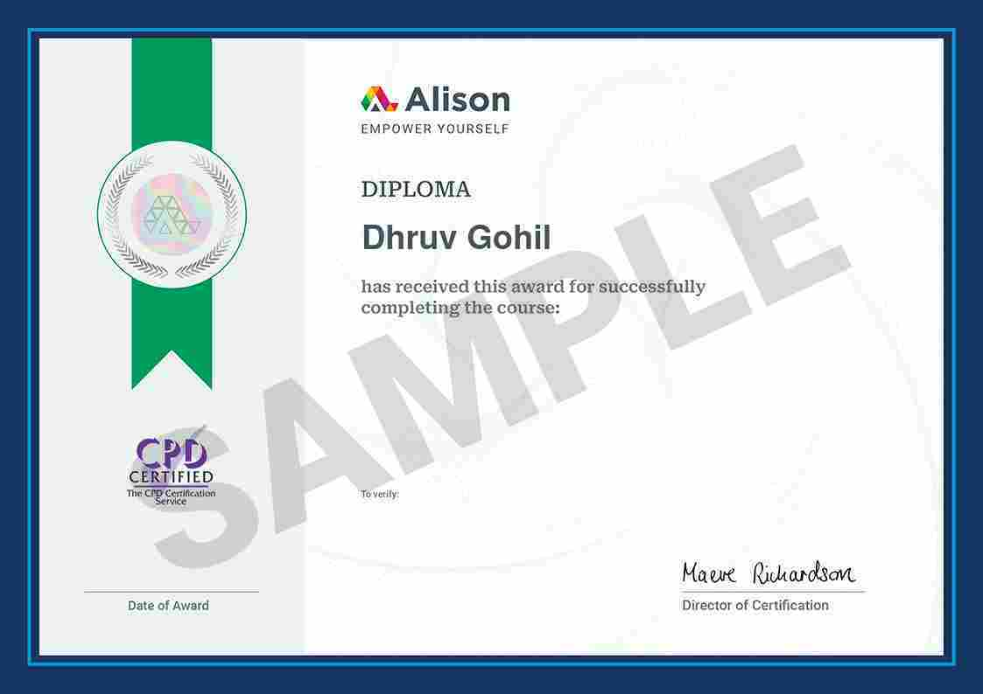

Slide 15
Thank you

